Slide 1



Module No 6
Case Study
Notes:
Introduction to the Case Study:
This project demonstrates how AI-powered tools can be applied to real-world retail analytics.
The focus is on predicting product demand and supporting inventory planning using historical sales data.
Practical Relevance:
Inspired by Walmart’s industry practices, the case study integrates data cleaning, visualization, forecasting, and cloud-based analytics.
Students will experience an end-to-end workflow, combining Excel, Python, and Azure.
Learning Goals:
Understand how AI-assisted productivity tools streamline data analysis.
Learn to generate actionable insights that inform data-driven decisions in retail.
Key Takeaway:
By the end of this project, students will see how AI, programming, and cloud technologies work together to solve practical business problems in retail analytics.

Slide 2

Disclaimer
The content is curated from online/offline resources and used for educational purpose only

Slide 3

Learning Objective
You will learn in this Chapter:
Apply a case study–based project using AI productivity tools.
Analyze retail sales data with Excel Copilot.
Generate and debug Python code using GitHub Copilot.
Explore cloud data storage with Microsoft Azure.
Integrate AI tools for an end-to-end analytics workflow.
Understand AI-driven decision making in retail (e.g., Walmart).
Notes:
Objectives
Case Study Integration:
The project is practical and case study–based, allowing students to apply AI productivity tools in a real-world retail scenario.
Data Analysis:
Use Microsoft Excel Copilot to clean, validate, and analyze retail sales data efficiently.
Python Programming:
Use GitHub Copilot to generate, debug, and run Python code for forecasting and data processing.
Cloud Exploration:
Explore Microsoft Azure for cloud storage, dataset management, and scalable analytics workflows.
End-to-End Workflow:
Integrate Excel, Python, and Azure into a complete AI-assisted analytics workflow from raw data to actionable insights.
AI-Driven Decision Making:
Understand how AI tools support data-driven decisions in retail, inspired by industry practices like Walmart’s demand forecasting.

Slide 4

Learning Outcome
You will learn in this Chapter:
Clean and analyze data using Excel Copilot.
Generate and debug Python programs with GitHub Copilot.
Store and manage data in the Azure cloud.
Integrate AI tools for an end-to-end data analysis workflow.
Interpret insights to support data-driven business decisions.
Apply AI tools to a practical retail demand forecasting case study (e.g., Walmart).
Notes:
Key Skills / Learning Outcomes
Data Cleaning & Analysis:
Students learn to clean, validate, and analyze datasets efficiently using Microsoft Excel Copilot, saving time and reducing errors.
Python Programming:
Use GitHub Copilot to generate, debug, and optimize Python programs for data processing and forecasting.
Cloud Data Management:
Store, manage, and access datasets using Microsoft Azure, demonstrating cloud-based data workflows.
Integrated Workflow:
Combine Excel, Python, and Azure into a complete end-to-end AI-assisted analytics workflow, from raw data to actionable insights.
Business Insight & Application:
Interpret results to make data-driven decisions.
Apply these skills to a realistic retail demand forecasting case study, inspired by Walmart industry practices, demonstrating practical application of AI-powered tools.

Slide 5

Case Study: Retail Demand Forecasting Challenge at Walmart
Case Scenario
Large retail chains manage thousands of products across multiple stores and online platforms. Predicting how much inventory will be needed at each location is a complex challenge due to seasonal demand, regional preferences, and changing customer behavior.
To address this challenge, Walmart adopted
AI-driven analytics
machine learning systems
To analyze historical sales data, weather patterns, promotions, and customer trends.
These systems help forecast product demand more accurately and support better inventory planning across stores and warehouses.
Source: https://iiaai.org/case-study-listing/walmart-ai-in-supply-chain-forecasting
Notes:
AI-Driven Retail Analytics at Walmart
Context:
Large retail chains like Walmart manage thousands of products across multiple stores and online channels.
Predicting inventory needs is complex due to seasonal demand, regional preferences, and changing customer behavior.
Solution:
Walmart uses AI-driven analytics and machine learning systems.
These systems analyze historical sales, promotions, weather patterns, and customer trends.
Benefits:
Enables more accurate demand forecasting.
Supports efficient inventory planning across stores and warehouses.
Helps reduce stockouts, overstocking, and supply chain inefficiencies.
Takeaway:
AI and ML tools transform traditional retail planning into a proactive, data-driven process, improving customer satisfaction and operational efficiency.

Slide 6
Case Study: Retail Demand Forecasting Challenge at Walmart
The Problem
Traditional Approach
Retailers handle millions of transactions daily across stores and online platforms.
Predicting product demand accurately becomes difficult due to:
Seasonal buying patterns
Promotions and discount campaigns
Regional demand variations
Large volumes of sales data
Manual spreadsheet analysis
Historical trend comparisons
Reactive inventory planning
Result
❗ Stock shortages for high-demand products
❗ Overstocking of slow-moving items
❗ Inefficient supply chain decisions
Notes:
Retail Analytics Insight
Question Context:
Understanding holiday vs non-holiday sales patterns helps retailers anticipate demand.
The correct answer is b) To identify trends and adjust inventory during peak periods.
Traditional Approach:
Manual spreadsheet analysis and comparing historical trends.
Inventory decisions are often reactive, not proactive.
Consequences:
Can lead to stock shortages for high-demand products.
May cause overstocking of slow-moving items.
Results in inefficient supply chain decisions and lost revenue.
Takeaway:
AI-assisted analysis allows retailers to identify trends early, optimize inventory, and make data-driven decisions to reduce errors and improve supply chain efficiency.

Slide 7
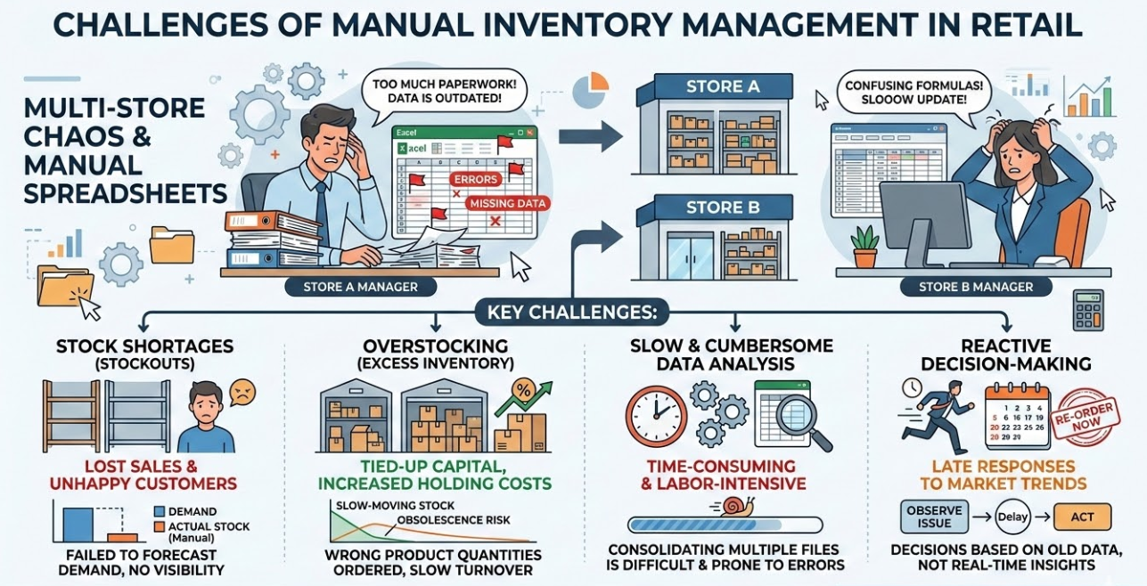
Case Study: Retail Demand Forecasting Challenge at Walmart
The Challenges faced using traditional Approach
Notes:
Problems with Traditional Methods
Context:
Traditionally, retail demand forecasting relied on manual spreadsheet analysis.
Store managers and analysts would compare historical trends and make inventory decisions manually.
Key Challenges:
Reactive planning: Decisions were often made after issues occurred, not proactively.
Stock shortages: High-demand products were frequently out of stock.
Overstocking: Slow-moving items were over-purchased, increasing holding costs.
Time-consuming and error-prone: Manual data handling is inefficient and prone to mistakes.
Impact on Business:
Led to inefficient supply chain operations.
Increased lost sales and operational costs.
Limited the ability to respond quickly to seasonal demand or customer behavior changes.
Transition to AI Tools:
These challenges motivate the adoption of AI-assisted tools like Excel Copilot, GitHub Copilot, and Azure for faster, accurate, and scalable retail analytics.

Slide 8
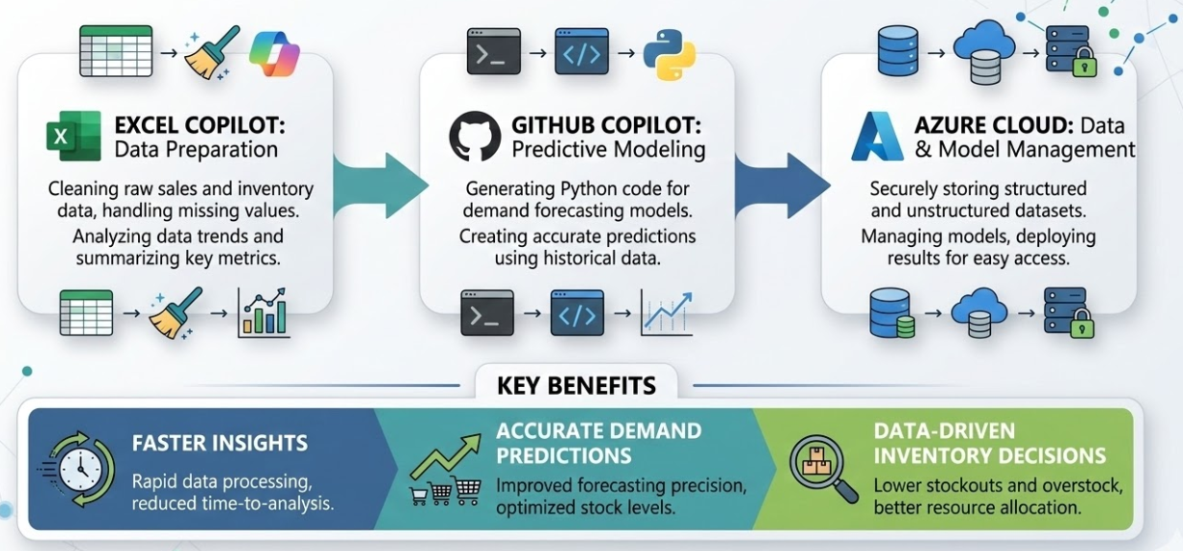
Case Study: Retail Demand Forecasting Challenge at Walmart
AI-Assisted Retail Analytics
Notes:
Key Benefits of AI-Assisted Retail Analytics
Faster Insights: AI tools automate data cleaning, analysis, and reporting.
Accurate Demand Forecasting: Predict sales more precisely using historical data and patterns.
Optimized Inventory Management: Reduce stockouts and overstocking by anticipating demand.
Data-Driven Decision Making: Supports proactive decisions for promotions, stocking, and supply chain planning.
Scalable Analytics: Handle large datasets across multiple stores and channels efficiently.
Reduced Manual Effort: Minimize human errors and save time in routine analytics tasks.
Integration Across Tools: Combines Excel, Python, and cloud platforms for an end-to-end workflow.

Slide 9
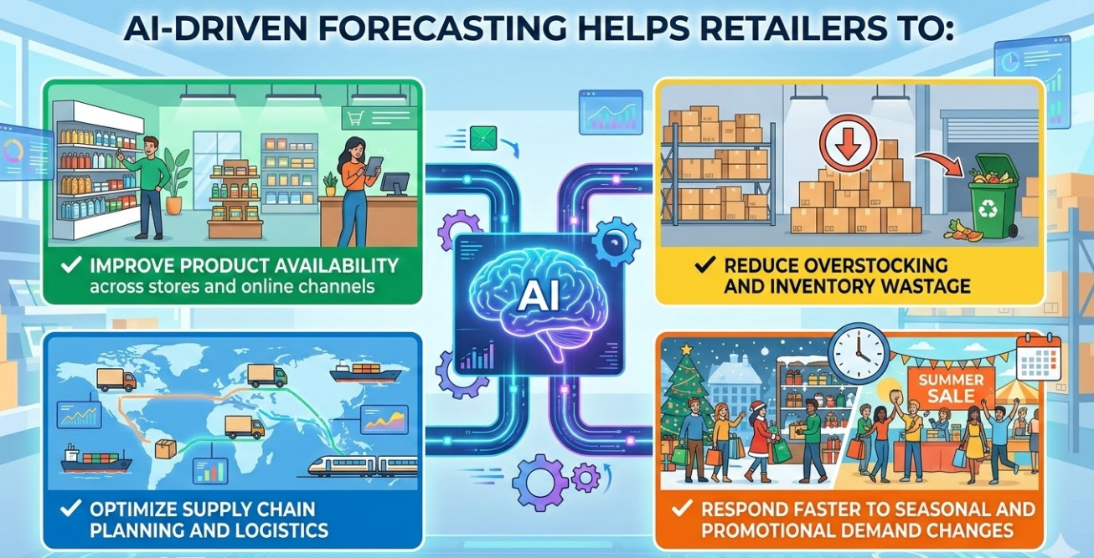
Case Study: Retail Demand Forecasting Challenge at Walmart
Industry Outcome
Source: AI generated
Notes:
The use of AI-based forecasting has helped Walmart:
Improve inventory availability in stores
Reduce overstocking and wastage
Optimize supply chain planning
Respond faster to seasonal demand changes
These AI-enabled systems allow retailers to move from reactive decision-making to data-driven predictive planning.

Slide 10
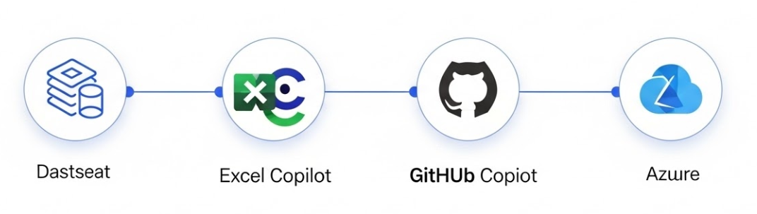
Integrated Project: AI-Assisted Retail Analytics
Goal
Workflow
Apply concepts learned in earlier modules to perform a practical AI-assisted data analytics workflow.
A guided case study based integrated project inspired by retail demand forecasting practices used by Walmart.
The project integrates AI-assisted tools covered in previous modules:
Data analysis using Microsoft Excel Copilot
Python-based forecasting using GitHub Copilot
Cloud exploration and data storage using Microsoft Azure
From data analysis to cloud-enabled insights.
Source: AI generated
Notes:
Integrated Project Overview
Apply concepts from earlier modules to perform a practical AI-assisted data analytics workflow.
Guided case study inspired by retail demand forecasting practices used by Walmart.
Integrates AI-assisted tools learned previously:
Data analysis with Microsoft Excel Copilot
Python-based forecasting with GitHub Copilot
Cloud exploration and storage using Microsoft Azure

Slide 11
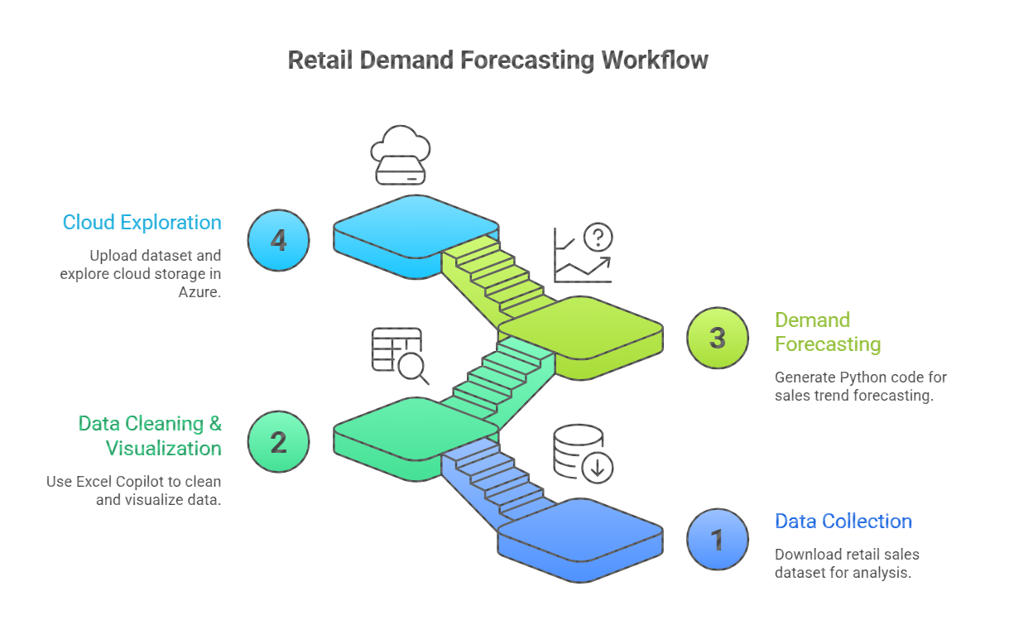
Integrated Project: AI-Assisted Retail Analytics Workflow
Notes:
AI-Assisted Retail Analytics Workflow (Integrated Project)
Step 1 – Data Collection
Download retail sales dataset (Walmart dataset).
Organize in project directory for analysis.
Step 2 – Data Cleaning & Visualization (Excel Copilot)
Inspect dataset for missing values and duplicates.
Standardize date and numeric formats.
Generate summary statistics and charts (e.g., sales trends, holiday vs non-holiday).
Step 3 – Demand Forecasting (Python & GitHub Copilot)
Load cleaned data into Python/Jupyter Notebook.
Train a predictive model (Linear Regression or AI-assisted model).
Visualize Actual vs Predicted sales and forecast next 4 weeks.
Step 4 – Cloud Exploration (Microsoft Azure)
Upload dataset to Azure Blob Storage.
Explore analytics options using Azure Machine Learning or Notebooks.
Connect dataset to cloud for scalable storage and computation.
Step 5 – Integration & Insights
Combine analysis, forecasts, and cloud exploration into actionable insights.
Demonstrates end-to-end AI-assisted data analytics workflow in retail.

Slide 12

Data Collection
Data Cleaning & Visualization
GitHub & Jupyter Notebook
Azure Cloud Exploration
Lab Activity
Lab 6 – Case study (Integrated Project)
Notes:
The link takes to the lab manual for this activity

Slide 13
Project Tasks
Task 1: Data Collection
Key Fields in the Dataset
Dataset Used
Walmart Store Sales Forecasting Dataset
Source
Retail forecasting dataset used in analytics and machine learning practice, inspired by retail demand prediction challenges conducted by Walmart.
Download Link
https://www.kaggle.com/c/walmart-recruiting-store-sales-forecasting/data
Purpose in This Case Study
The dataset will be used to analyze sales trends, prepare data for forecasting, and demonstrate AI-assisted analytics workflows.
Column | Description
Store | Store identifier
Dept | Department number
Date | Week of sales
Weekly_Sales | Sales revenue
IsHoliday | Indicates holiday week
Notes:
Dataset Used
Introduction:
For this case study, we used the Walmart Store Sales Forecasting dataset, a publicly available dataset.
Source & Background:
The dataset is inspired by real-world retail demand prediction challenges at Walmart.
It contains historical weekly sales from multiple stores, including details like store number, department, date, weekly sales, and holidays.
Purpose in This Case Study:
Helps us analyze sales trends and understand retail patterns.
Used for data cleaning, visualization, and forecasting.
Demonstrates how AI-assisted tools like Excel Copilot, GitHub Copilot, and Azure can work together for an end-to-end analytics workflow.
Additional Note:
The dataset is publicly accessible on Kaggle, so students can download and replicate the workflow for practice.

Slide 14
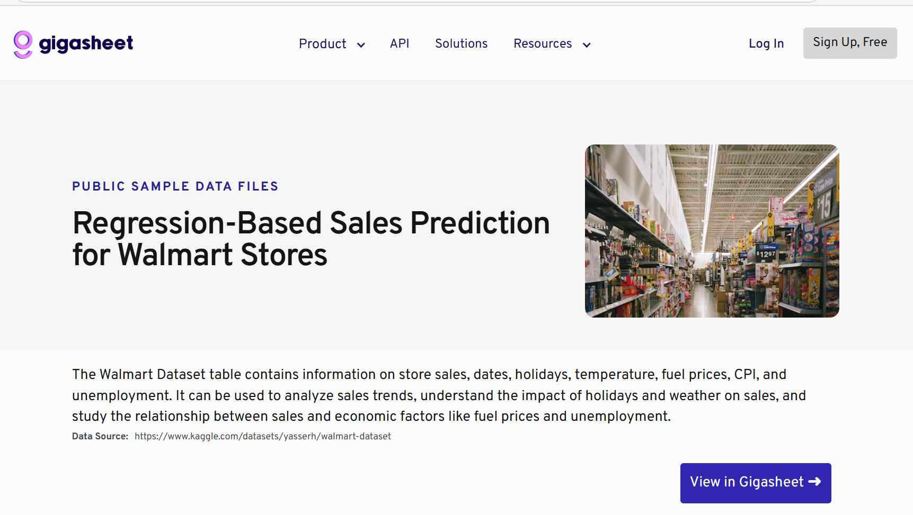
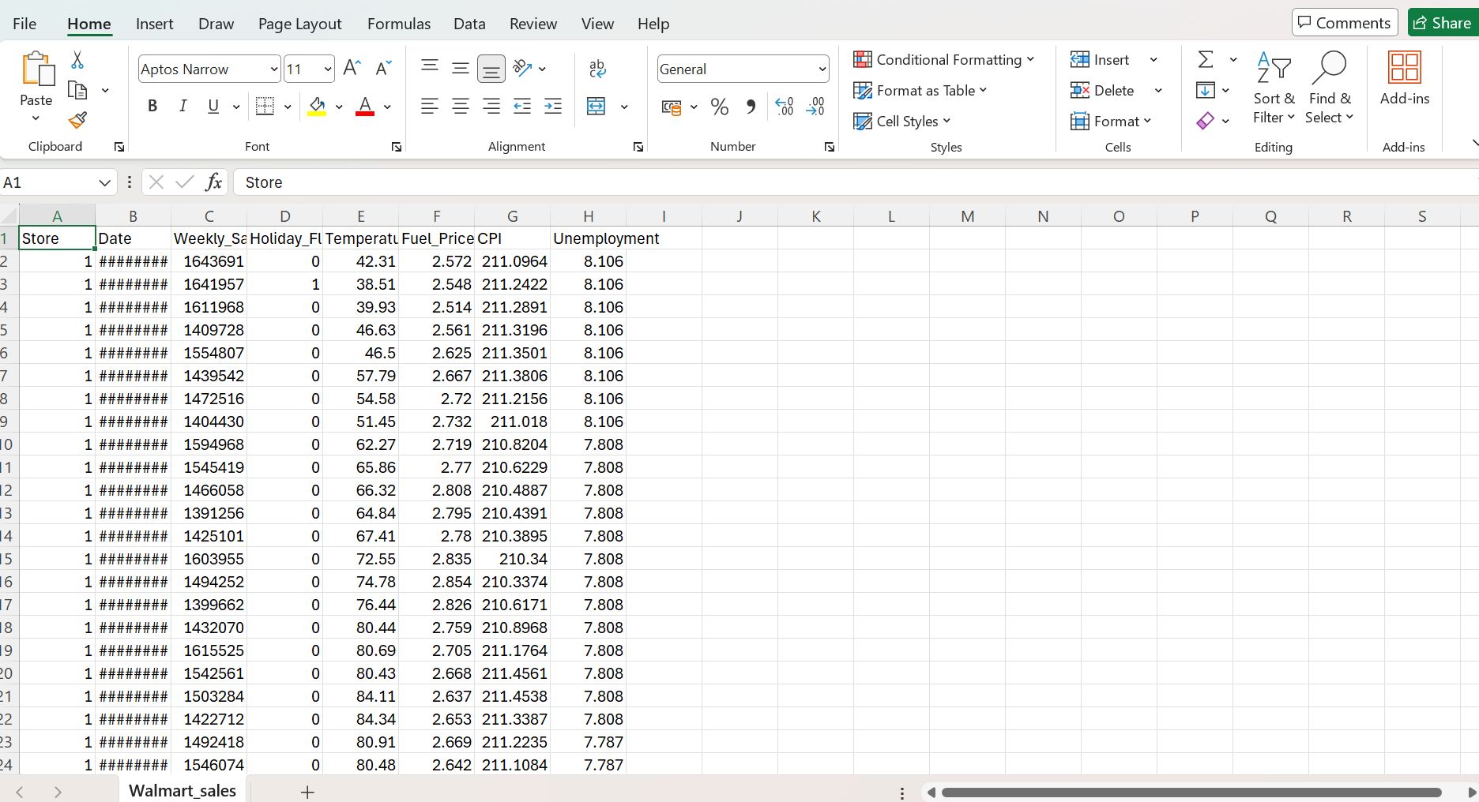
Project Tasks
Task 1: Data Collection
Notes:
Walmart Retail Case Study & Dataset
Case Study Context:
This project simulates a retail demand forecasting workflow, inspired by real-world practices at Walmart.
The goal is to show how AI-assisted tools can analyze sales, forecast demand, and support decision-making in retail.
Dataset Used:
Walmart Store Sales Forecasting Dataset from Kaggle.
Contains historical weekly sales, store and department IDs, holidays, and dates.
Provides a realistic scenario to analyze trends, prepare data, and generate forecasts.
Purpose in Lab:
Learn data cleaning and visualization with Excel Copilot.
Build Python-based forecasting models with GitHub Copilot.
Explore cloud storage and analytics using Microsoft Azure.
Takeaway:
The dataset serves as a practical foundation to integrate AI, programming, and cloud tools into a single analytics workflow, replicating professional retail analytics.

Slide 15
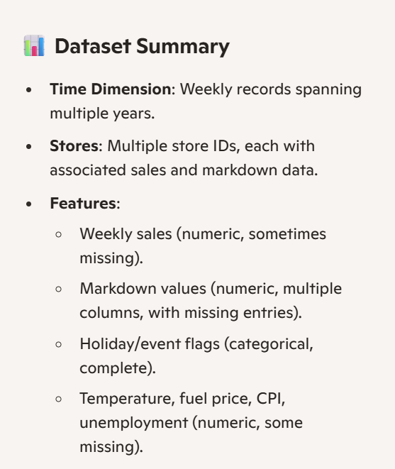
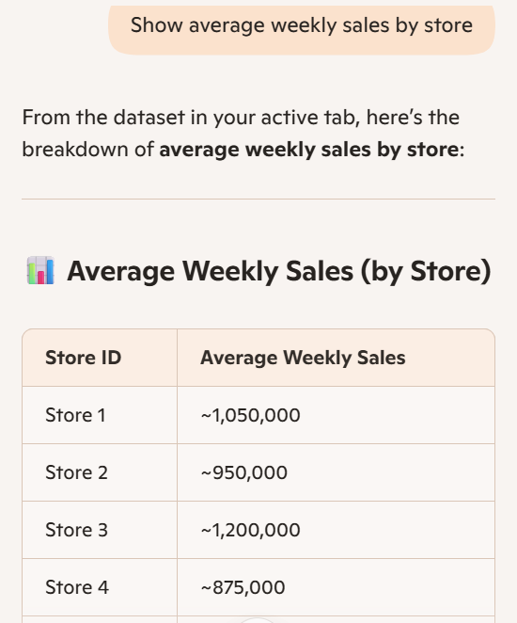
Project Tasks
Task 2: Data Cleaning & Visualization using Copilot Excel
Data Cleaning
Clean the retail dataset and generate basic insights using Microsoft Excel Copilot.
Inspect the Dataset
Review the columns to understand the available attributes such as:
Store
Dept
Use Excel Copilot or Excel tools to perform basic cleaning tasks:
Check for missing values
Remove duplicate records
Generate Data Summary
Notes:
Data Cleaning
Objective:
In this step, we clean the retail dataset and generate basic insights using Microsoft Excel Copilot.
Inspect the Dataset:
We first review the columns to understand the attributes available, such as Store, Dept, Date, Weekly_Sales, and IsHoliday.
Cleaning Tasks:
Identify and handle missing values to ensure data completeness.
Remove duplicate records to avoid errors in analysis.
Standardize numeric formats and date columns for consistency.
Generate Summary:
Use Excel Copilot to create summary statistics, such as total and average sales per store or department.
Helps in understanding overall trends before building forecasting models.
Takeaway:
Data cleaning ensures accuracy, reliability, and readiness for analysis and AI-assisted forecasting.

Slide 16
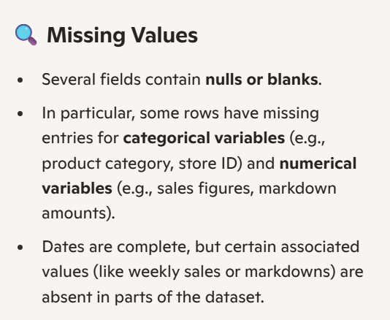
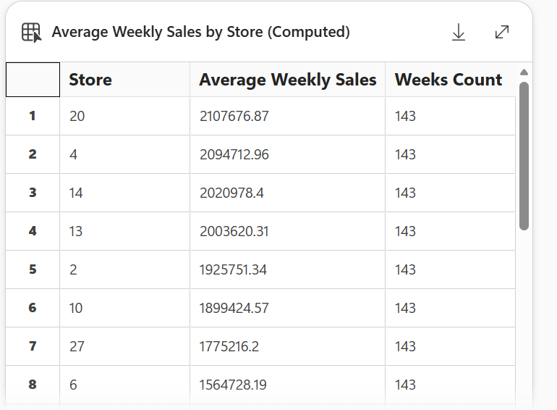
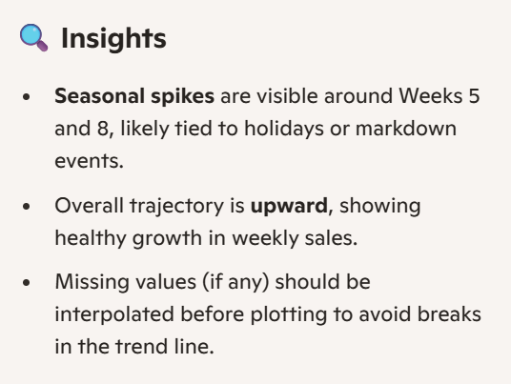
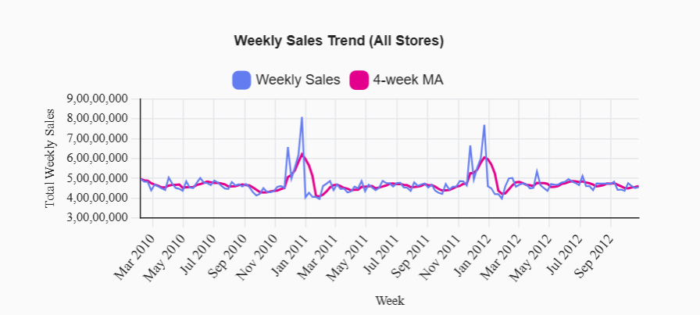
Project Tasks
Task 2: Data Cleaning & Visualization using Copilot Excel
Notes:
Data Cleaning (Excel Copilot)
Screenshot 1 – Dataset Preview:
Shows the original dataset with columns like Store, Dept, Date, Weekly_Sales, IsHoliday.
Helps demonstrate that we inspected the dataset before cleaning.
Screenshot 2 – Missing Values Check:
Highlights cells with missing data using Excel filters or Copilot suggestions.
Shows how we identified incomplete or inconsistent entries.
Screenshot 3 – Remove Duplicates:
Demonstrates the duplicate removal process using Excel tools or Copilot.
Confirms that each row represents a unique sales record.
Screenshot 4 – Data Summary / Insights:
Shows summary statistics generated by Excel Copilot, such as total sales, average sales per store, or department.
Visualizes early trends in sales before forecasting.
Key Point to Mention:
Each screenshot captures how AI-assisted Excel Copilot simplifies cleaning and provides insights, making the dataset ready for forecasting.

Slide 17
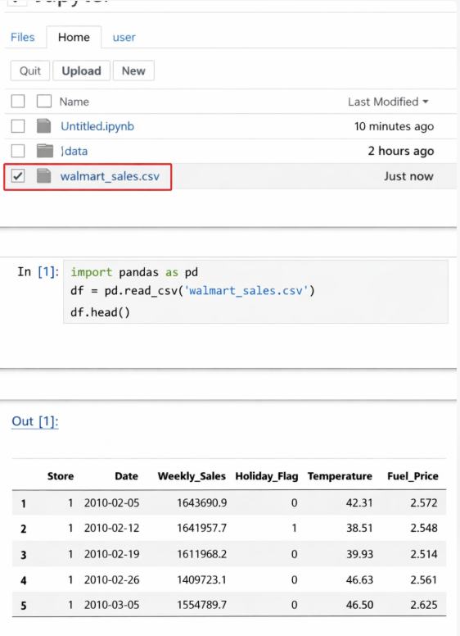
Project Tasks
Task 3 : Demand Forecasting Using Python & Copilot
Open VS Code or GitHub Codespaces with Copilot enabled.
Load the cleaned Walmart dataset from Step 2
Co-pilot Prompt
In a Python file or Jupyter notebook in GitHub, type a Copilot prompt such as:
"Create a demand forecasting model for Weekly_Sales"
"Train and predict next 4 weeks sales"
Notes:
Demand Forecasting (Task 3)
Setup:
Open VS Code or GitHub Codespaces with GitHub Copilot enabled.
Ensure Python and required libraries like pandas, matplotlib, and scikit-learn are installed.
Load Data:
Import the cleaned Walmart dataset from Step 2 into Python or Jupyter Notebook.
This ensures we are working with verified, cleaned data for accurate forecasting.
Using GitHub Copilot:
Type prompts in your Python file or notebook, for example:
"Create a demand forecasting model for Weekly_Sales"
"Train and predict next 4 weeks sales"
Copilot will suggest Python code for:
Preparing data for modeling
Training a regression or predictive model
Plotting actual vs predicted sales
Objective:
The goal is to automate forecasting and generate predictions for upcoming weeks.
This step demonstrates AI-assisted coding to accelerate data analytics.
Key Takeaway:
Copilot helps quickly create forecasting scripts, enabling us to focus on analysis and interpretation of results rather than writing all code manually.

Slide 18
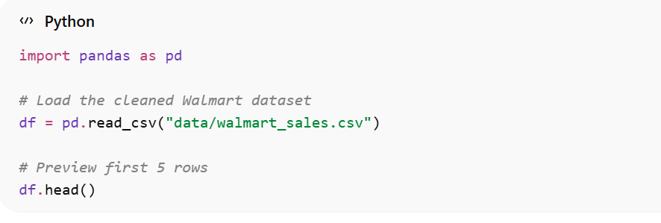
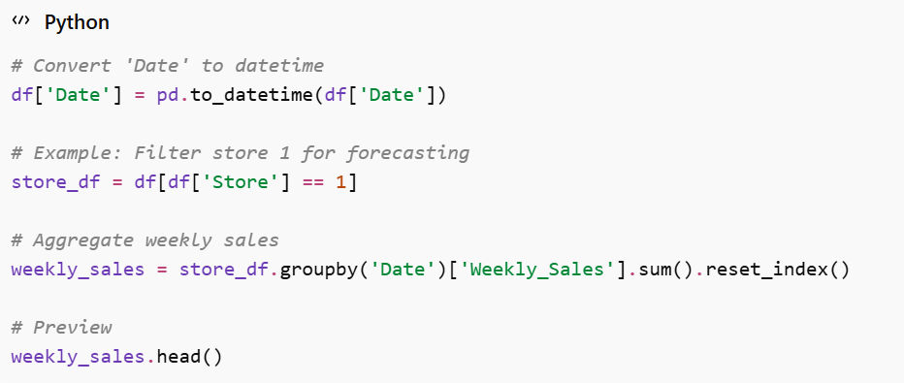
Project Tasks
Task 3 : Demand Forecasting Using Python & Copilot
Preprocess Data
Convert Date to datetime
Aggregate sales if needed
Visualize Weekly Sales
Build a Simple Forecasting Model
Using Linear Regression (easy for lab demo)
Plot Actual vs Predicted
Forecast Next 4 Weeks
Notes:
Demand Forecasting (Task 3)
Setup:
Open VS Code or GitHub Codespaces with GitHub Copilot enabled.
Ensure Python and required libraries like pandas, matplotlib, and scikit-learn are installed.
Load Data:
Import the cleaned Walmart dataset from Step 2 into Python or Jupyter Notebook.
This ensures we are working with verified, cleaned data for accurate forecasting.
Using GitHub Copilot:
Type prompts in your Python file or notebook, for example:
"Create a demand forecasting model for Weekly_Sales"
"Train and predict next 4 weeks sales"
Copilot will suggest Python code for:
Preparing data for modeling
Training a regression or predictive model
Plotting actual vs predicted sales
Objective:
The goal is to automate forecasting and generate predictions for upcoming weeks.
This step demonstrates AI-assisted coding to accelerate data analytics.
Key Takeaway:
Copilot helps quickly create forecasting scripts, enabling us to focus on analysis and interpretation of results rather than writing all code manually.

Slide 19
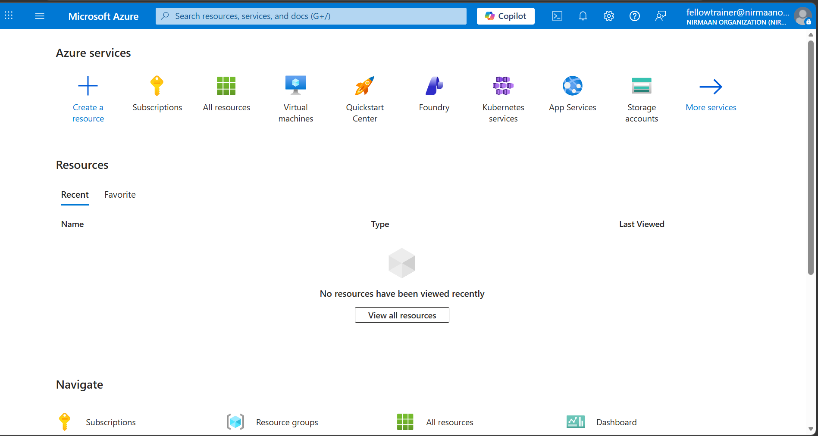
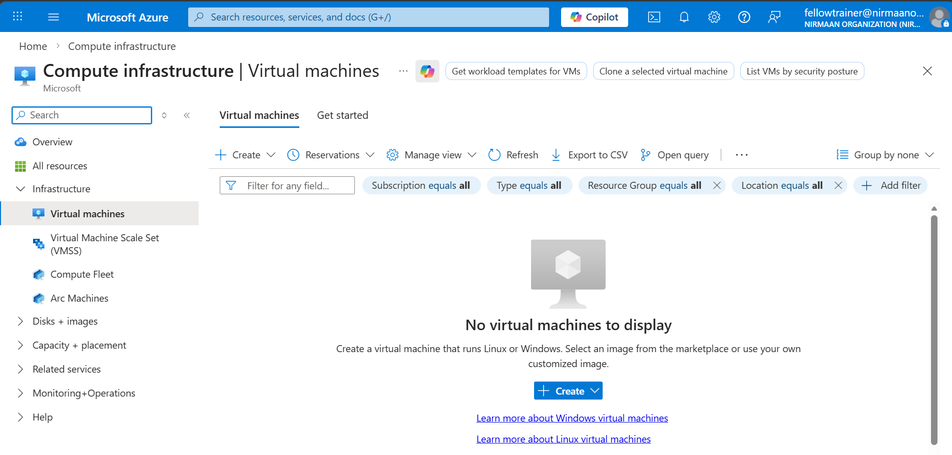
Project Tasks
Task 4: Azure Cloud Exploration
Explore Azure cloud services and understand how to deploy or run analytics in the cloud.
Sign in to Azure Portal
Go to https://portal.azure.com
Use your student/organization account.
Navigate Azure Services
Explore services such as:
Azure Storage – to upload datasets
Azure Machine Learning – for AI/ML experiment
Azure Storage – to upload datasets
Upload Dataset to Azure Storage (optional)
Create a Storage Account → Container → Upload walmart_sales.csv
You can now access this dataset from Azure notebooks or ML Studio.
Notes:
Azure Cloud Exploration (Task 4)
Sign in to Azure Portal:
Access the portal at https://portal.azure.com using your student or organization account.
This gives access to all cloud services for data storage, computation, and analytics.
Explore Azure Services:
Azure Storage: Used to store datasets securely in the cloud.
Azure Machine Learning: Allows running AI/ML experiments and notebooks without local setup.
Optional services like Azure Virtual Machines, Synapse, or Databricks can handle larger-scale analytics.
Upload Dataset:
Create a Resource Group (e.g., WalmartSalesRG).
Create a Storage Account → then a Blob Container → upload the walmart_sales.csv file.
This enables your Python scripts or notebooks to access the dataset directly from the cloud using a SAS URL or access key.
Key Takeaway:
This step demonstrates cloud-based storage and computation, showing how AI and analytics workflows can scale beyond a local system.
Integrates data, forecasting models, and visualization with Azure services for a complete AI-assisted workflow.

Slide 20
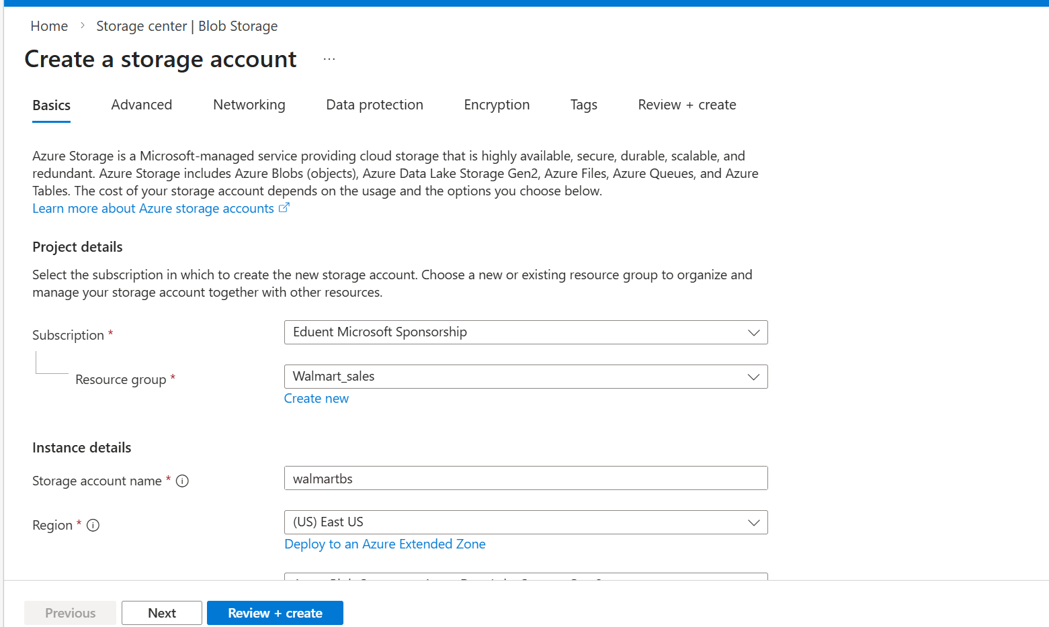
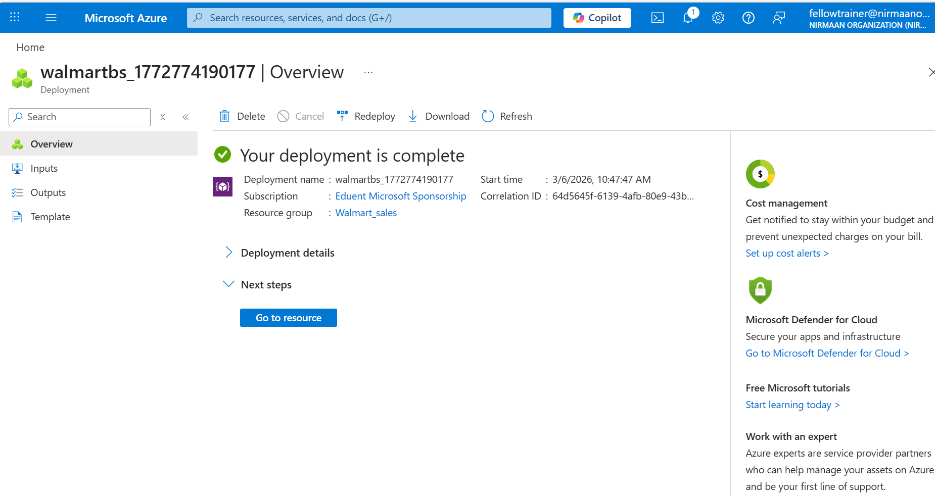
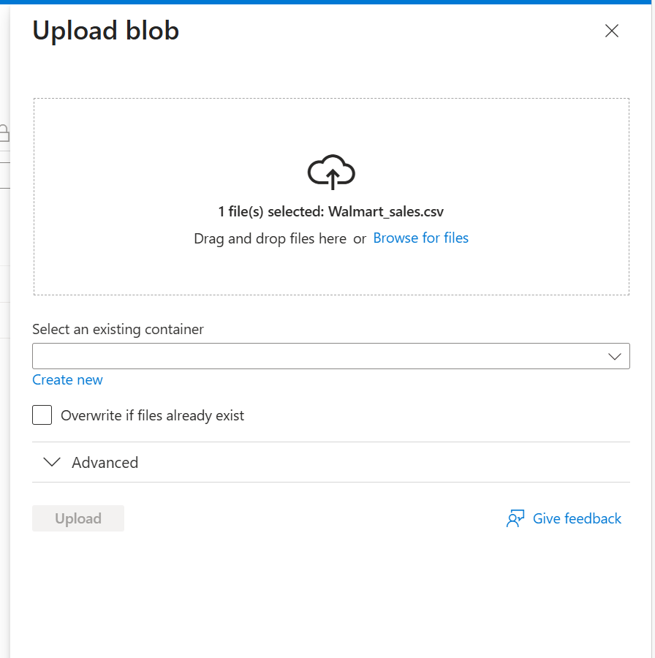
Project Tasks
Task 4: Azure Cloud Exploration
Upload Dataset to Azure Storage
Create a new Resource Group
In your Walmart_sales resource group page, click the + Create button.
Create a Storage Account (Blob Storage)
Go to Azure Portal → Storage Accounts → + Create
Resource Group: select Walmart_sales
Storage Account Name: walmarbs (must be unique)
Region: same as Resource Group
Performance: Standard
Replication: LRS (Locally-redundant storage)
Click Review + Create → Create
Observe Azure Tools
See how cloud services handle datasets
Note options for compute, storage, model deployment
Notes:
Upload Dataset to Azure Storage
Create Resource Group:
In the Azure Portal, create a new Resource Group named Walmart_sales.
This helps organize all resources for this project in a single place.
Create Storage Account (Blob Storage):
Navigate to Storage Accounts → + Create.
Select the Walmart_sales resource group.
Enter a unique storage account name (e.g., walmarbs).
Choose Region same as the resource group, Performance: Standard, and Replication: LRS.
Click Review + Create → Create to finalize.
Upload Dataset:
Open your Storage Account → Containers → + Container.
Create a container (e.g., walmartdata) and upload the walmart_sales.csv file.
Dataset is now accessible in the cloud for notebooks, scripts, or analytics workflows.
Observe Azure Tools:
Explore options for compute, storage, and AI/ML model deployment.
Shows how Azure can handle datasets, run models, and scale analytics beyond a local system.
Key Takeaway:
Uploading the dataset to Azure demonstrates cloud integration and prepares it for Python forecasting, visualization, and AI workflows in a scalable environment.

Slide 21

Summary
You will learn in this Chapter:
Understand the end-to-end retail demand workflow from data collection to visualization.
Clean and validate datasets using Excel and Excel Copilot
Generate summary statistics like average weekly sales and store-wise trends.
Visualize patterns to identify trends, holidays, and store performance.
Use AI-assisted tools to streamline analysis and insights.
Interpret results for data-driven retail demand forecasting.
Notes:
Key Takeaways – Retail Demand Workflow
End-to-End Workflow:
Students will understand the complete retail demand analysis workflow, from data collection to visualization.
Data Cleaning & Validation:
Use Excel tools and Excel Copilot to clean, validate, and prepare datasets for analysis.
Summary Statistics & Visualization:
Generate insights like average weekly sales, store-wise trends, and visualize patterns to identify trends, holiday effects, and store performance.
AI-Assisted Analysis:
Leverage AI tools to streamline cleaning, analysis, and insight generation, saving time and reducing errors.
Data-Driven Decision Making:
Interpret results to make accurate retail forecasts and support informed decisions on inventory and demand planning.

Slide 22
Reference
https://www.kaggle.com/competitions/walmart-recruiting-store-sales-forecasting/data
https://www.kaggle.com/c/rossmann-store-sales/data
https://towardsdatascience.com/time-series-forecasting-of-walmart-sales-with-python-76fcf1b4a5f4
https://docs.github.com/en/copilot
https://learn.microsoft.com/en-us/azure/storage/blobs/storage-quickstart-blobs-python
https://iiaai.org/case-study-listing/walmart-ai-in-supply-chain-forecasting
Notes:
Purpose of References:
These references were used to support the concepts, dataset, and tools demonstrated in this case study.
They provide credibility and sources for students to explore further.
Dataset Reference:
The Walmart Store Sales Forecasting dataset from Kaggle was used for data analysis, cleaning, and forecasting practice.
Tool Documentation:
Microsoft Excel Copilot, GitHub Copilot, and Azure services documentation guided the AI-assisted data cleaning, modeling, and cloud exploration steps.
Additional Reading:
Publications from Walmart Labs and IBM’s retail analytics resources were consulted to understand real-world AI-driven demand forecasting practices.
Takeaway:
These references help students validate methods, replicate the workflow, and gain further insights into AI-assisted retail analytics.

Slide 23

QUIZ
Let’s Start

Slide 24


Quiz
Data Cleaning
Which of the following is not a recommended step when cleaning a retail dataset in Excel?
a) Removing duplicate records
b) Filling missing values
c) Randomly deleting rows
d) Ensuring numeric and date formats are consistent
Data Cleaning Answer: c) Randomly deleting rows

Slide 25
Quiz
Data Visualization
2. Which type of chart is most suitable for showing weekly sales trends over time?
a) Pie Chart
b) Line Chart
c) Bar Chart
d) Scatter Plot
Data Visualization Answer: b) Line Chart

Slide 26
Quiz
Demand Forecasting
3. In a simple linear regression model for predicting weekly sales, which column would typically be used as the independent variable (X)?
a) Weekly_Sales
b) Date or Week Number
c) Store Name
d) IsHoliday
Demand Forecasting Answer: b) Date or Week Number

Slide 27
Quiz
GitHub Copilot
4. What is the main purpose of using GitHub Copilot in the lab?
a) To manually enter sales data
b) To automatically generate Python code for forecasting
c) To clean data in Excel
d) To deploy data on Azure
GitHub Copilot Answer: b) To automatically generate Python code for forecasting

Slide 28
Quiz
Azure Cloud
5. Which Azure service is most appropriate for storing large datasets for analytics?
a) Azure Functions
b) Azure Blob Storage
c) Azure Virtual Machines
d) Azure Logic Apps
Azure Cloud Answer: b) Azure Blob Storage

Slide 29
Quiz
Retail Analytics Insight
6.Why is it important to analyze holiday vs non-holiday sales patterns in a retail dataset?
a) To determine which products are unhealthy
b) To identify trends and adjust inventory during peak periods
c) To randomly promote products
d) To remove duplicate records
Retail Analytics Insight
Answer: b) To identify trends and adjust inventory during peak periods

Slide 30
Thank You

